Slide 1
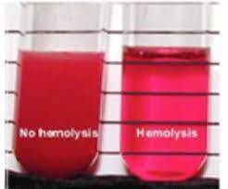
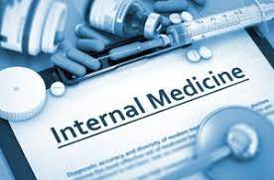
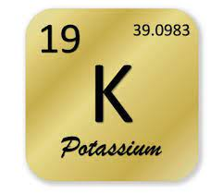
Investigation of Sample Rejection Reasons from Clinical Biochemistry
Laboratory
Hayriye Aydın, Şehabettin Selek², Tuğçe Yıldız², Hifa Gülru Çağlar³
¹Bezmialem Vakif University, School of Medicine, Istanbul, Turkey
²Bezmialem Vakif University, School of Medicine, Department of Medical Biochemis, Istanbul, Turkey
³Sağlık Bilimleri University, Faculty of Medicine, Department of Medical Biochemistry, İstanbul, Turkey
Introduction
61.033 of the samples that were accepted to the Bezmialem Vakıf University central laboratory between 01/08/2019 - 01/08/2020 were rejected. Among the rejected examples, the most demanding department was Emergency Medicine (25.6%), the most wanted unit Emergency Polyclinic (28.8%), the most wanted service Internal Medicine Service (15.7%,). With 57.2%, a higher rejection rate was found in the samples from inpatients than in outpatients. Hemolysis was the most common reason for rejection in 30 of 36 episodes with 100%.
Results
Clinical laboratories have a very important role in terms of patient safety due to their effects on the diagnosis and treatment of patients (1). The majority of laboratory errors originate from the pre-analytical phase which, are largely preventable (2). With this study, our aim is to investigate sample rejection rates, its causes and to determine the preventable causes in Bezmialem Vakıf University Hospital Medical Biochemistry Laboratory.
Materials and Methods
Conclusion
In conclusion, most sample rejection samples are preventable. It is recommended that each laboratory investigate its own reasons for rejection, the personnel comply with the ideal blood collection conditions, and the staff gets training on the key principles to reduce rejection rates.
Rejected samples were divided into groups considering the requested test, the priority of the test, the department where the patient was located, the characteristics of the tube, the time the sample was taken, the time the sample was accepted, the time between the time the sample was taken and the admission to the laboratory, the personnel who took the sample, and the reason for the sample rejection (3). Data on rejected samples were expressed as rejection rate and percentage within groups.
Reason for rejection | Most Coming Service | Which parameter is the most
1.Hemolysis %73.7 -44965 samples | Internal diseases service %16.2 -3813 samples | Potassium %7.8-3499 samples
2. Other %8.2-5005 samples | Gastroenterology Service %14.1-344 samples | ALT %50.4 2521 samples
3. Clotted Sample %4.7-2850 samples | Internal medicine service %20.8-329 samples | Urea %84.9 - 2421 samples
4.Inadequate sample %3.1-1872 samples | Anesthesia intensive care %20.8-220 samples | Uric acid %54.4-398 samples
5.Below Sample Level %3.1- 1998 samples | Anesthesia intensive care %20-197 samples | Whole blood hemogram %71.8-1362 samples
6.people whose samples were not taken properly %2.6-1616 samples | Internal medicine service %16.2-137 samples | Urea %44.4 - 718 samples
7. Faulty Sample Container %1.5 - 913 samples | Gastroenterology Service %22.6 -93 samples | Amylase %52.7-481 samples
8. Faulty Test Registration %1-629samples | Gastroenterology service %25.4-93 samples | APTT %88.9 -559 samples
9. Lipemic %0.6-362 samples | Cardiology service %32.2-58 samples | Whole blood hemogram %100-362 samples
10.Faulty Barcoding %0.5-334 samples | Internal diseases service %48.7-58 samples | ALT %100 -334 samples
11. Faulty Sampling %0.4-221 samples | Organ Transplant Service 25.6-32 samples | Amylase %98.2-217 samples
12.above Sample Level %0.3-162 samples | Internal diseases service %40.6-28 samples | Troponin %100 - 162 samples
13. Icteric %0.2-92 samples | Brain surgery service %45.5-15 samples | Whole blood hemogram %100-92 samples
14.Name-surname Errors %0.1-68 samples | Anesthesia Intensive Care %66.1% - 39 samples | 25 hydroxy vitamin D %100-62 samples
References
1. Sciacovelli L, Plebani M. The IFCC Working Group on laboratory errors and patient safety. Clinica Chimica Acta. 2009;404(1):79-85.
2. Simundic A-M, Lippi G. Preanalytical phase--a continuous challenge for laboratory professionals. Biochem Med (Zagreb). 2012;22(2):145-9.
3. Rooper L, Carter J, Hargrove J, Hoffmann S, Riedel S. Targeting Rejection: Analysis of Specimen Acceptability and Rejection, and Framework for Identifying Interventions in a Single Tertiary Healthcare Facility. J Clin Lab Anal. 2017;31(3):e22060.

